Slide 1
Step 2: COE Phase 1 Building Project: SEC and SLINK
December 17, 2018
Mark Riley, Ph.D.
Professor of Biological Systems Engineering
Associate Dean for Research, College of Engineering

Slide 2
Agenda
Where are we today
  Research activities, facilities
What pressures are coming
  Growth goals, RCM Budget model
Where do we want to go
  Faculty survey
How do we get there

Slide 3
Questions we will address:
What Research areas map to laboratory categories so as to organize our space?
What are the specific facility requirements and adjacency needs for each lab category?

Slide 5
New budget model coming for NU System
“President Hank Bounds, the campus chancellors and members of the Board of Regents worked with the National Center for Higher Education Management Systems for more than a year to develop a new model for allocating funding to the campuses.
Beginning in the 2018-19 fiscal year, NU will allocate its resources based on student credit hours, adding weight to programs that are more expensive to deliver, such as master’s programs and courses in engineering and medicine.
The modest change in our funding model will more equitably distribute resources based on student credit hour production and put us in the best possible position to ensure that all University of Nebraska students receive a high-quality education,” he wrote.
https://journalstar.com/news/local/education/new-nu-budget-allocation-means-less-state-funding-for-unl/article_1f30caa2-d94e-5de7-af1f-b8a50adde3d7.html

Slide 6
Potential new budget steps using RCM:
Responsibility Centered Management
From U Arizona:
  Are RCUs be charged rent for space and how can they afford that?
  The university historically charged the cost of space against central resources, reducing the amount of revenue available to distribute to colleges. In RCM, RCU's RCM budgets were increased by the cost of the space they occupied at the implementation of RCM. The cost of space is then charged back to RCUs. In other words, at the start of RCM nothing changed. But, going forward, as an RCU changes the amount of space that is assigned to them their costs will change so the efficient use of space benefits an RCU.
RCM balances Revenues (Tuition, Sponsored Research, Gifts) with Expenses (Salaries + Benefits, Facilities use, Operations)
Space has a cost which needs to be covered by its activity.
  Common approach is a charge of $X / ft for laboratory space per year.
  This is often balanced using F&A generated by sponsored projects

Slide 9
Ideas from COE F/S afternoon breakout 12/6/18

Slide 11
What does Phase 1 include?
 | Room Use Code | SLINK NOW | SEC NOW | Total |  | SEC Renovated | SEC Minor Remodel | NEW SLINK | Total
Classroom facilities | 100 | 699 | 5,862 | 6,561 |  | 1,300 | 2,881 | 3,750 | 7,931
Laboratory (Instruction) | 200 | 1,740 | 16,261 | 18,001 |  | 8,880 | 6,162 |  | 15,042
Research (non-class) Lab | 250 |  | 52,704 | 52,704 |  | 17,860 | 18,713 | 35,432 | 72,005
Office | 300 | 11,574 | 11,681 | 23,255 |  | 12,770 | - | 4,440 | 17,210
Special use | 500 |  | 8,073 | 8,073 |  |  |  |  | -
Totals |  | 14,013 | 94,581 | 108,594 |  | 40,810 | 27,756 | 43,622 | 112,188

Slide 12
Types of Laboratory Categories, based on constructed facilities
Type of space | Needs for each space
Biosafety | POSITIVE PRESSURE, Biosafety Cabinet, Autoclave, space for refrigerators & centrifuges, lab gas, vacuum
Measurement & Microscopy | Vibration isolation, snorkles for venting, 110/220, 3 phase power, visual isolation, access to fume hoods, lab gas, vacuum
Wet & General Purpose | NEGATIVE PRESSURE, chemical hoods, space for refrigerators, lab gas, vacuum
Fabrication & Materials Testing | Easy access to loading dock, reinforced floors for heavy equipment, noisy space
Electronic & General Purpose | Dry lab w/ no chemical or biosafety hoods, no large sinks, movable bench tops, 3 phase power, 110/220
Workplace | Movable furniture, benches, reconfigurable space (like high bay)
Storage | Equipment, materials not in active use, may include shelving
Office | Office space for one or more individuals, could be large shared space for multiple grad students
Teaching Lab | Laboratory scheduled for class activities, may or may not need specialized equipment.
Teaching Lecture | Classroom for lecture or recitation sessions.

Slide 13
Amount of space in each Laboratory Category, based on constructed facilities
 | Biosafety | Measurement & Microscopy | Wet, Chemical & Hazardous Materials, & General Purpose | Fabrication & Materials Testing | Electronic & General Purpose | Workplace | Storage | Office | Teaching Lab | Teaching Lecture
Nebraska Hall |  |  |  | 194 | 328 | 9,913 | 3,546 | 27,273 | 425 | 6,214 | 47,893
SLINK |  |  |  |  |  | 1,361 |  | 11,574 |  | 3,639 | 16,574
SEC | 5,500 | 2,839 | 8,601 | 10,302 | 27,240 | 14,225 | 4,302 | 12,445 | 7,099 | 5,213 | 97,766
Othmer | 7,275 | 1,455 | 4,365 |  | 1,455 |  | 376 | 2,250 | 3,655 |  | 20,831
Avery |  |  |  |  | 1,400 | 3,000 |  | 4,000 | 2,500 |  | 10,900
Schorr |  |  |  | 545 | 2,300 |  |  | 2,500 | 4,000 |  | 9,345
PKI | 1,972 | 651 |  | 15,693 | 18,396 |  |  | 15,346 | 2,093 | 14,730 | 68,881
STC |  |  |  |  | 3,490 |  |  | 3,425 |  | 3,670 | 10,585
Total | 14,747 | 4,945 | 12,966 | 26,734 | 54,609 | 28,499 | 8,224 | 78,813 | 19,772 | 33,466 | 282,775

Slide 14
Discuss potential Research themes
Goal is to bring in close proximity researchers who are doing similar work.
  Enhance interaction of teams (student to student)
  Co-locate similar facility needs (ie, wet labs, biosafety).
  Potential for some communal lab facilities (access to autoclave, refrigerator suite, microscopy).
What are those themes?
  Goal for the discussion:
    Highlight Research Excellence – where we have (or can build) international renown
    Have breadth (more than 2 research groups)
    Collectively themes are comprehensive of COE Research (but not too many themes)

Slide 15
Approach A:
COE Sponsored Research by Area
New awards garnered each year | AY18 | AY17
Biomedical Engineering | 11% | 7%
Energy Materials and Energy Systems | 4% | 11%
Engineering in Agriculture, Natural Resources, and Life Sciences | 20% | 22%
Materials and Manufacturing | 24% | 17%
National Defense and Security | 18% | 19%
Transportation and the Built Environment | 22% | 23%
 | 100% | 100%

Slide 16
Approach B:
More detailed themes
Robotics/Controls/Systems
Biomedical/Environmental-(this includes the informatics)
Materials and Manufacturing-(note that the NEAT labs will likely remain in the high bay, so mostly this area is materials)
Mechanics and structures-(maybe a lot of this will still be in the high bay?)
Photonics and Electronics
Power and Energy

Slide 17
Approach C:
Suggestions from COE Faculty

Slide 18
 | % Square footage
Area of Research | Biosafety | Measurement & Microscopy | Wet, Chemical & Hazardous Materials, & General Purpose | Fabrication & Materials Testing | Electronic & General Purpose | Workplace | Total
Biomedical Engineering | 55% | 10% |  |  | 35% |  | 100%
Energy Materials and Energy Systems |  | 10% | 10% | 10% | 70% |  | 100%
Engineering in Agriculture, Natural Resources, and Life Sciences | 30% |  | 40% |  | 20% | 10% | 100%
Materials and Manufacturing |  | 10% | 20% | 30% | 20% |  | 100%
National Defense and Security | 10% | 10% |  | 20% | 30% | 10% | 100%
Transportation and the Built Environment |  |  |  | 30% | 10% | 60% | 100%

Slide 19
Draft Lab Facility Categories

Slide 20
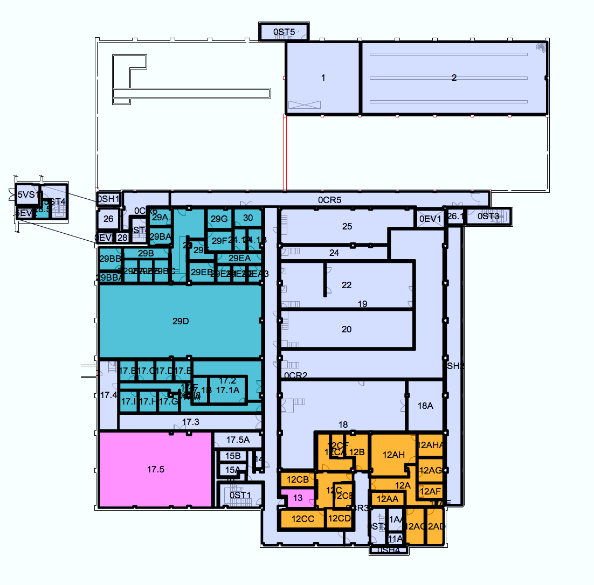
S.E.C. Basement
Biosafety
Office
M&M
Teaching
Lab
Wet
Chem
Teaching Lecture
F&M
Test
Elec
&G.P.
Work
Space
Storage

Slide 21
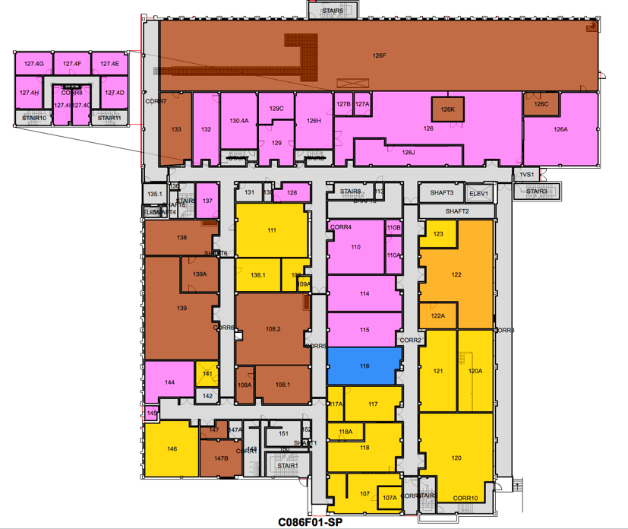
S.E.C. 1st Floor
Biosafety
Office
M&M
Teaching
Lab
Wet
Chem
Teaching
Lecture
F&M
Test
Elec
&G.P.
Work
Space
Storage

Slide 22
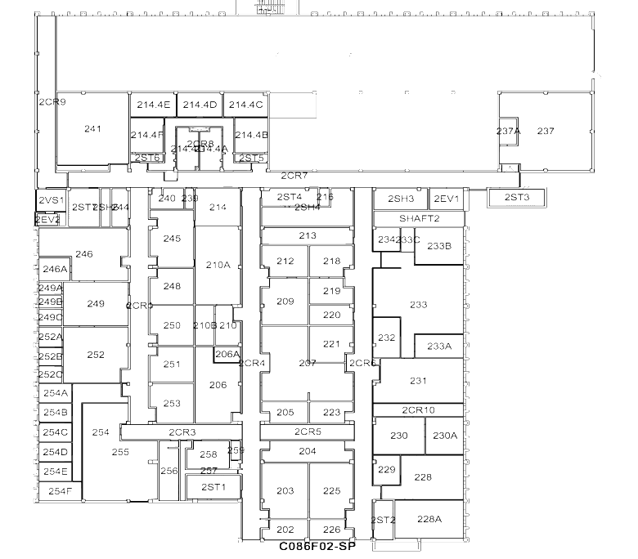
S.E.C. 2nd Floor
Biosafety
Office
M&M
Teaching
Lab
Wet
Chem
Teaching
Lecture
F&M
Test
Elect
&G.P.
Work
Space
Storage

Slide 23
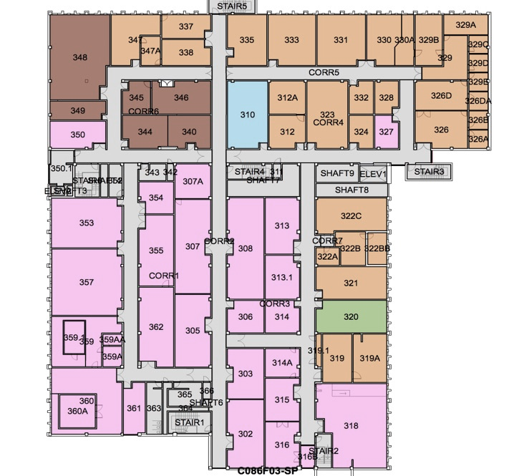
S.E.C. 3rd Floor
Biosafety
Office
M&M
Teaching
Lab
Wet
Chem
Teaching
Lecture
F&M
Test
Elec
& G.P.
Work
Space
Storage

Slide 24
Facility questions to address for each Lab Category
Structural issues
  Special floor loading: X kg
  Vibration sensitivity
  Door width (stnd or oversized)
  Floor finish (water impervious, chem resistant, carpet)
  Ceiling type (acoustic, washable, special)
Mechanical
  Lab sink (single, double)
  Emergency shower, eye wash
  Instrument cooling water
  Specialty water
  Compressed air
  House vacuum
  Specialty vacuum
  Floor drain
Ventilation
  Temperature (normal, tolerance goals)
  Chemical hazards (acids, solvents, flammable toxic)
  Fume hood
  Biological safety cabinet
  Relative humidity
Electrical
  General receptacle (120v, 15A)
  Special outlet (120v, 1ph, 20A)
  Special outlet (208v, 1ph, 20A)
  Special outlet (208v, 3ph, 20A)

Slide 25
Adjacency questions to address for each Lab Category
Wants
  Space with shared equipment
    Refrigerators, centrifuge, balance, MilliQ water, Bio Safety Cab
  Space with shared specialty equipment
    Microscopes, lasers, vacuum chambers
Needs
  Easy access to autoclave
  Light protection (laser safety)
  Isolation space (sound, light, fumes)
  Isolation space for Sensitive research (Export Control / ITAR Restricted, IP concerns)

Slide 26
Questions we will address:
What Research areas map to laboratory categories so as to organize our space?
What are the specific facility requirements and adjacency needs for each lab category?

